Slide 1
Play Store App Review Analysis
By Mudassir Kamran
Data Science Trainee, AlmaBetter
2025
Capstone Project

Slide 2
WHY ANALYZE THE GOOGLE PLAY STORE?
01
Mobile App Market is set to grow 20% by 2023
02
Android Apps comprise 90% of the Mobile App Market
03
What makes an App popular? Can we predict how popular it’s going to be?
04
What are some interesting patterns in user behavior related to app usage & feedback

Slide 3

MUDASSIR KAMRAN
Data Scientist
I am a data scientist with a steady focus on clean analysis and clear insight. I work with real world datasets to find patterns that support sound decisions. My approach stays grounded in strong exploration, visual study and simple models that answer business needs. I aim to turn raw data into clear guidance that helps teams shape better products and improve user reach.

Slide 4
THE VISION
To turn raw Play Store data into insight that guides smart action.
THE VISION

Slide 5
THE VISION
INTRODUCTION
Play store is an Android Market serves as the official app store for certified devices running on the Android Operating system.
Developed and Operated by Google, launched on 6th March, 2012.
Approximately 3.48 million apps are in the Play store. Play store apps have their own features such as Ratings, Reviews, Size and more. From the problem statement given, we should analyze the given database and should come up with the key factors that increased the number of users, long term usage etc., the objective of this project is to deliver insights to understand customer demands better and thus help developers to popularize the product.

Slide 6
THE VISION
THE VISION
Two datasets are provided, one with basic information (play store Data.csv and the other with user reviews (User Reviews.csv) for the respective app.

Slide 7

We must examine and evaluate the data in both datasets in order to identify the important characteristics that inﬂuence app engagement and success.

Slide 8
THE VISION
Attributes in Google Play store Data
App: Name of the app on PlayStore
Category: The category of the app
Rating: App rating out of 5
Reviews: Number of reviews of the app on AppStore
Size: The memory size needed to install the application in MB/KB/GB
Installs: Number of user installed the app
Type: Weather the app is Free or Paid
Price: Price of the app of paid (0 if free)
Content Rating: The audience for which the app is Teen/Adult/Everyone
Genres: The genre under which the app lies
Last Updated: When was the last time the developer pushed an update
Current Ver: The onging version of the app
Android Ver: The supported android version

Slide 9
SWOT
OVERVIEW OF ANALYSIS
DATA CLEANING
PREDICTIVE MODELING
DATA EXPLORATION
DATA VISUALIZATION
Understand the structure of the doreataset and clean data bef analysis
Making the insights more readable and understandable for the clients
Formulate a statistical model to forecast an outcome using relevant predictors
Uncover initial patterns, characteristics, and points of interest using visual exploration

Slide 10
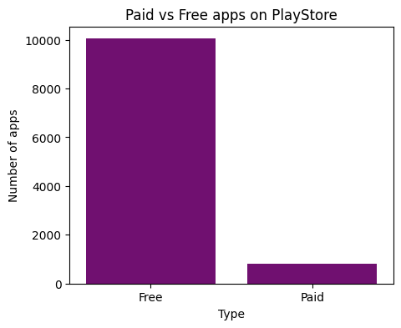
PAID APPS VS FREE APPS
When comparing the both plots, people are showing more interest on free apps like art & design.
And The number of free apps are more than 10000

Slide 11
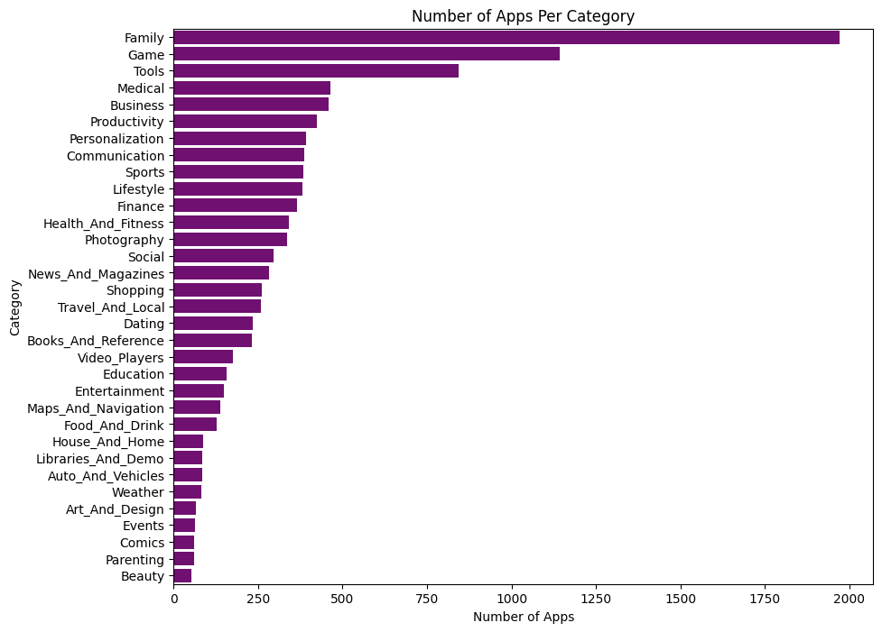
NUMBER OF APPS PER CATEGORY
Family and Game apps have the highest market prevalence. Surprising Tools, Business and Medical apps are also at the Top Count of applications.

Slide 12
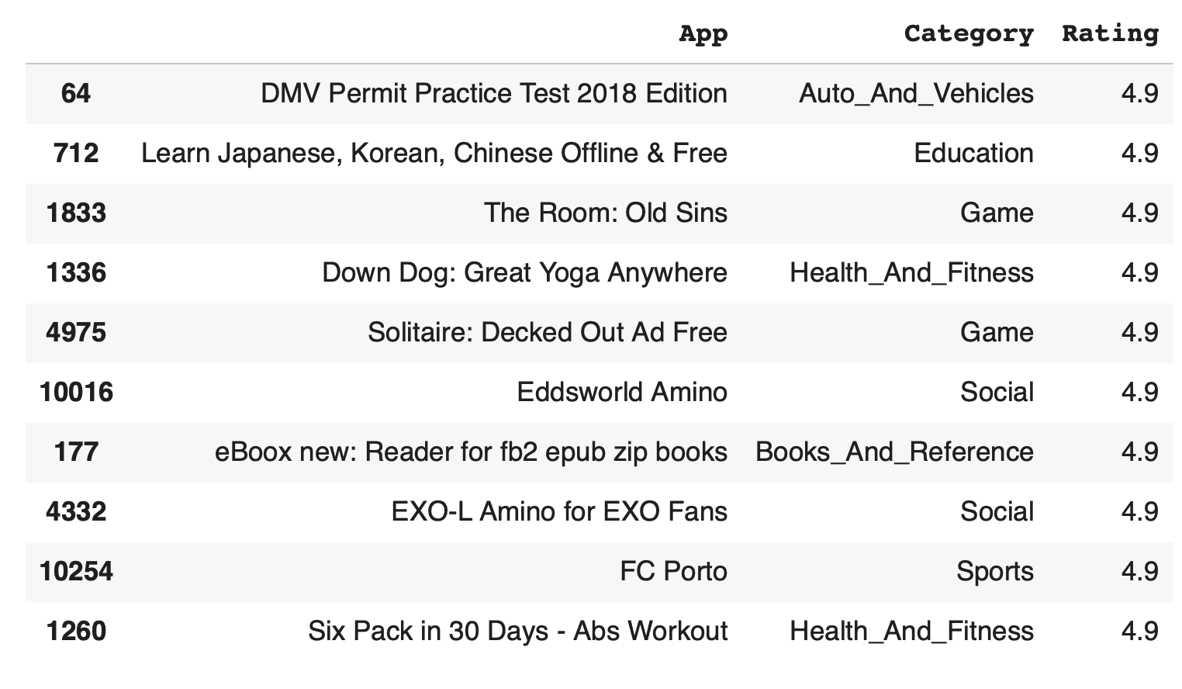
MOST RATED APPS HAVING MORE THAN 1000 REVIEWS
Categories like Games, Education, and Social are having comparatively more amount of apps count.

Slide 13
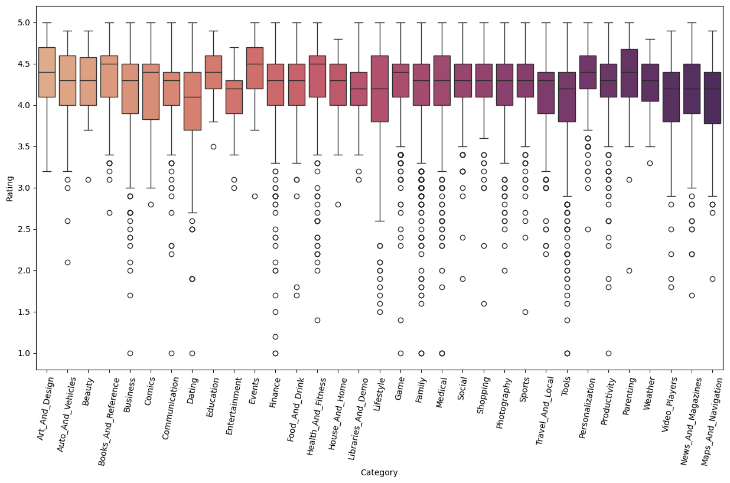
CATEGORY VS RATING
Each box shows the middle range of ratings in that category. A tight box means ratings stay steady. A wide box means ratings shift a lot.
The top and bottom lines show the high and low rating reach for that category.
The circles are outliers that sit far from the main rating pattern.
Most categories hold ratings near four or higher. This means users tend to score apps well across the store.
Some categories show many low outliers. This suggests uneven app quality in those groups.

Slide 14
OBJECTIVES
OBJECTIVES
v
01
Top 10 Highest rating Apps in google play store in terms of categories
02
Number of Application in terms of Category
03
Top 10 apps which has more downloads
04
Which 10 apps from the 'FAMILY' category are having the lowest rating and highest rating.

Slide 15
CONCLUSION
THANK YOU
Any questions?

